Slide 1
AI-GUARDIAN
Real-Time Scam Detection & Emergency Alert System
Professor : MONISHA H M

Slide 2
Contents
01
Introduction
02
Problem Statement
03
Project Overview/Working
04
Features
05
System Architecture
06
Technology used
07
Use Cases
Confidential

Slide 3
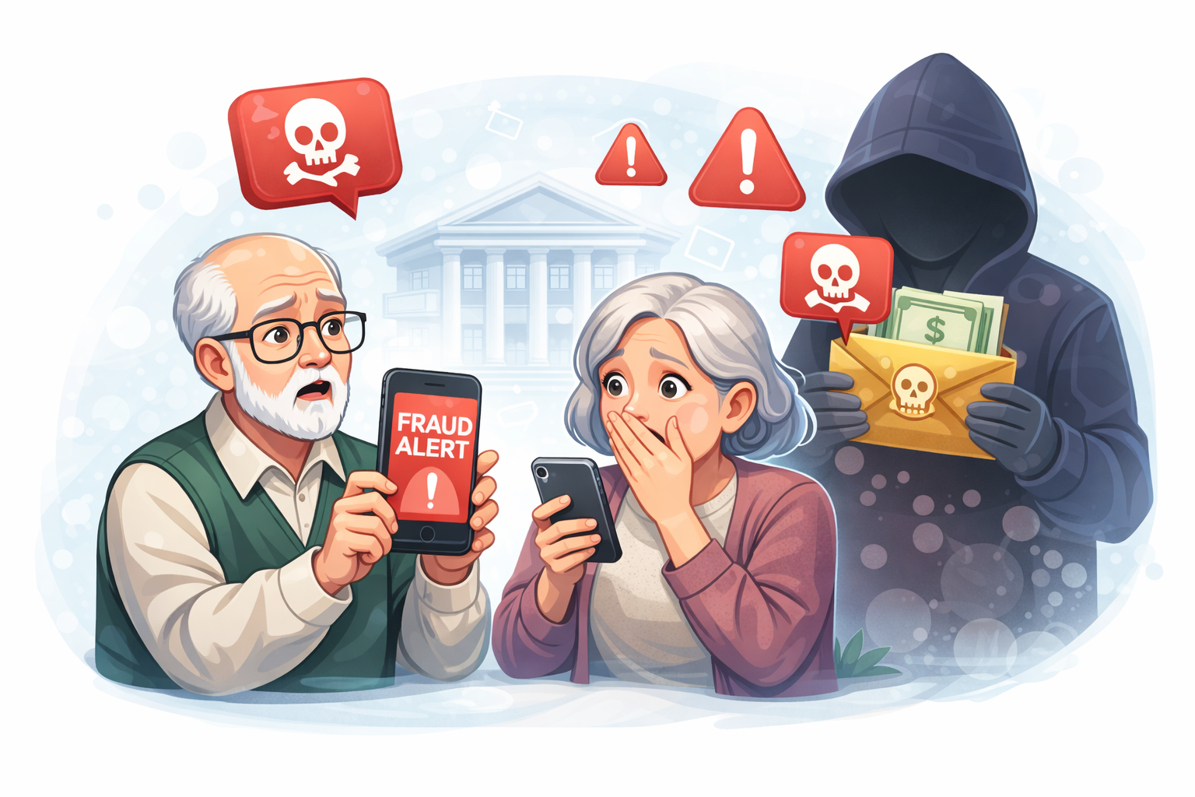
Introduction
Online scams and digital fraud are increasing rapidly.
Elderly and vulnerable users are most affected by such threats.
Many users find it difficult to identify scam messages or suspicious links.

Slide 4
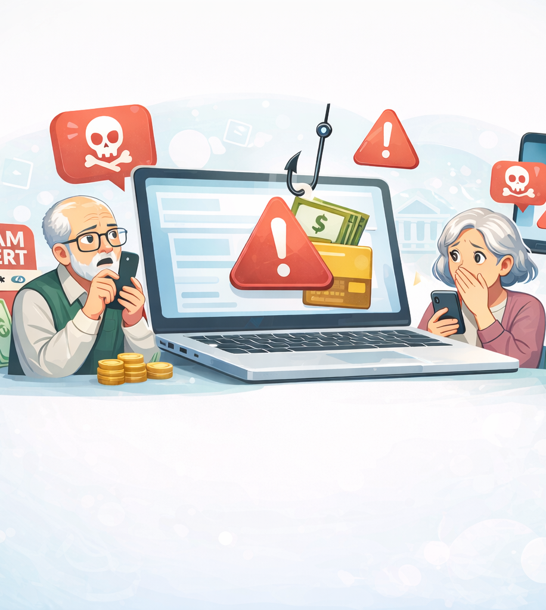
Problem Statement
There is a need for a system that can automatically detect scam risks.
The system should alert users and their family members in real time.
This helps reduce financial loss and digital security threats.

Slide 5
User enters message, text, or link.
System analyzes input for scam patterns.
Risk level is assigned (Low / High).
Low Risk → User is informed.
High Risk → Alert sent to emergency contacts and admin.
PROJECT OVERVIEW/WORKING
Confidential

Slide 6
Features
Secure User Registration & Login
Scam Detection with Risk Classification
Safety Alerts & Guardian Notifications
Multi-Language and Senior-Friendly Interface
Admin Dashboard & Session Management

Slide 7
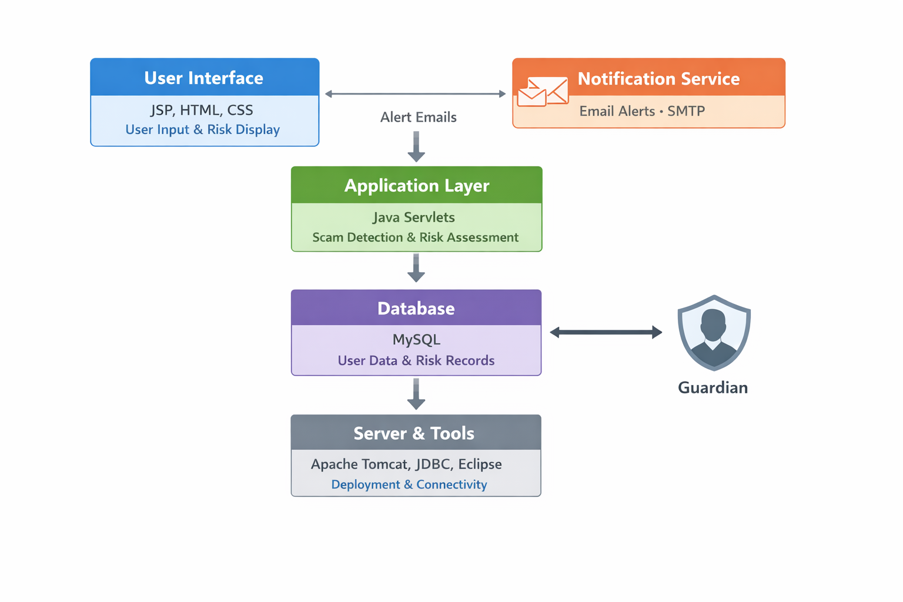
System Architecture
User Interface – Input & display
Application Layer – Detection & risk analysis
Database – User & alert data
Notification Service – Guardian alerts
Server & Tools – Deployment

Slide 8
Technology Used
Java (JDK 21)
JSP & Servlets
JDBC
MySQL
HTML & CSS
Apache Tomcat 9
SMTP Email Service
Eclipse IDE

Slide 9
Use cases
User Registration & Login – User creates account and accesses system
Message Scam Detection – User submits message for scam analysis
Risk Classification – System assigns risk level to message
Safety Tips Display – System shows appropriate safety guidance
Guardian Alert Notification – Guardian is notified for high-risk cases
Multi-Language Support – User selects preferred language
Admin Monitoring – Admin views alerts and system activity

Slide 10
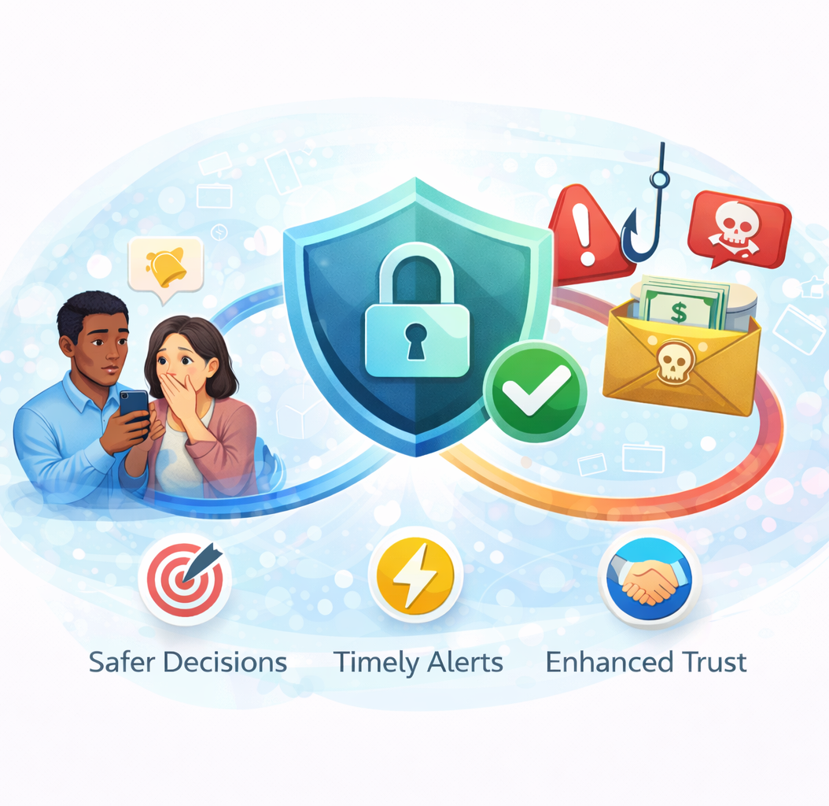
CONCLUSION
Promotes safer decision-making in digital interactions
Connects timely alerts with user awareness
Enhances trust and confidence in online communication

Slide 11
Thank you!
Thank you for your time and attention.
Confidential

